Slide 1


Adaptation of Diffusion Models for Remote Sensing Imagery
Authors: Ettari Adriano, Nappa Antonio, Azpiroz Izar, Quartulli Marco, Longo Giuseppe

Slide 2
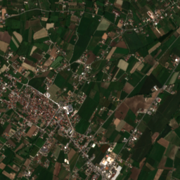
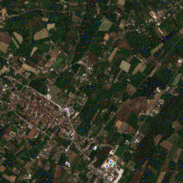
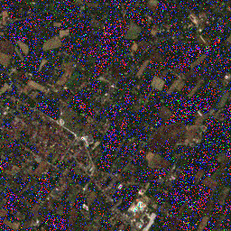
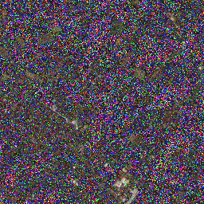








DIFFUSION MODEL
😎
😎
😎
😎
…
$$X_{0}$$
$$X_{1}$$
$$X_{2}$$
$$X_{T−2}$$
$$X_{T−1}$$
$$X_{T}$$
😀
😌
🤔
😥
Ends with high
quality sample
Easier as there is
less and less noise
Not easy but some
clues appear
Starting the reverse
process is hard

Slide 3
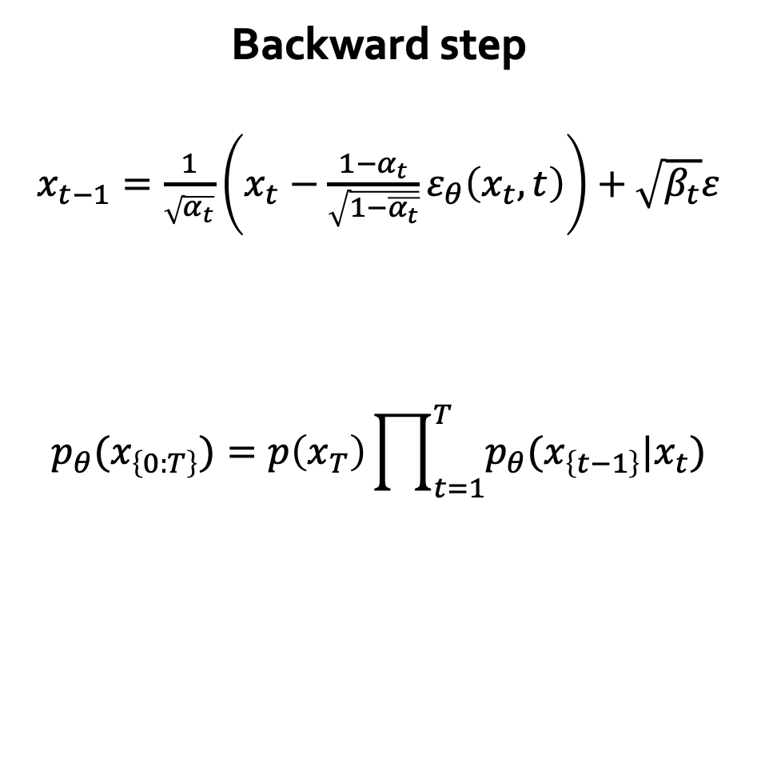
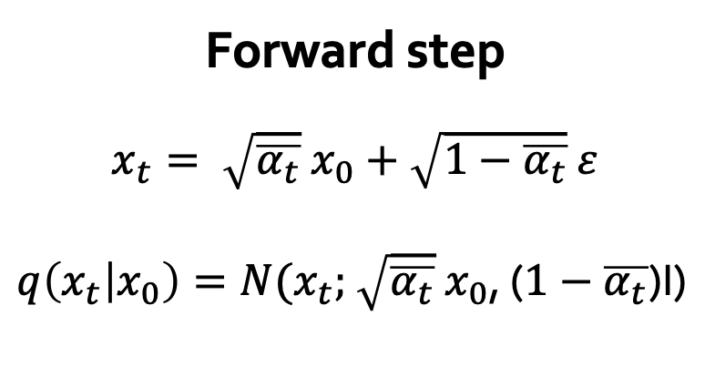
DIFFUSION MODEL
Some math
Forward step
$x_{t}= \sqrt{\overline{α_{t}}} x_{0}+\sqrt{1−\overline{α_{t}}}$ $ε$
$q\left(x_{t} | x_{0}\right)=N(x_{t};$ $\sqrt{\overline{α_{t}}} x_{0}$, ($1−\overline{α_{t}}$)I)
Backward step
$x_{t−1}=\frac{1}{\sqrt{α_{t}}}\left(x_{t}−\frac{1−α_{t}}{\sqrt{1−\overline{α_{t}}}}ε_{θ}\left(x_{t},t\right)\right)+$ $\sqrt{β_{t}}ε$
$$p_{θ}(x_{\left\{0:T\right\}})=p\left(x_{T}\right)\prod_{t=1}^{T}{p_{θ}(x_{\left\{t−1\right\}}|x_{t})}$$
$$p_{θ}\left(x_{\left\{t−1\right\}} | x_{t}\right)=N(x_{\left\{t−1\right\}};μ_{θ}\left(x_{t},t\right),Σ_{t})$$

Slide 4
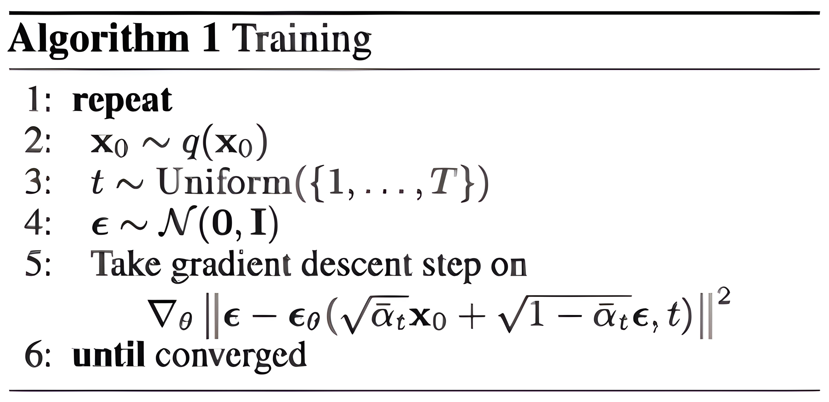
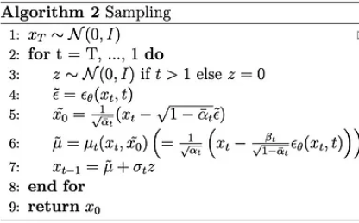

DIFFUSION MODEL
Algorithms
Initial isotropic gaussian noise sampling
Sample random noise (if not last step)
Estimated noise in current noisy data
Estimated $x_{0}$ from estimated noise
Mean for previous step sampling
Previous step sampling

Slide 5
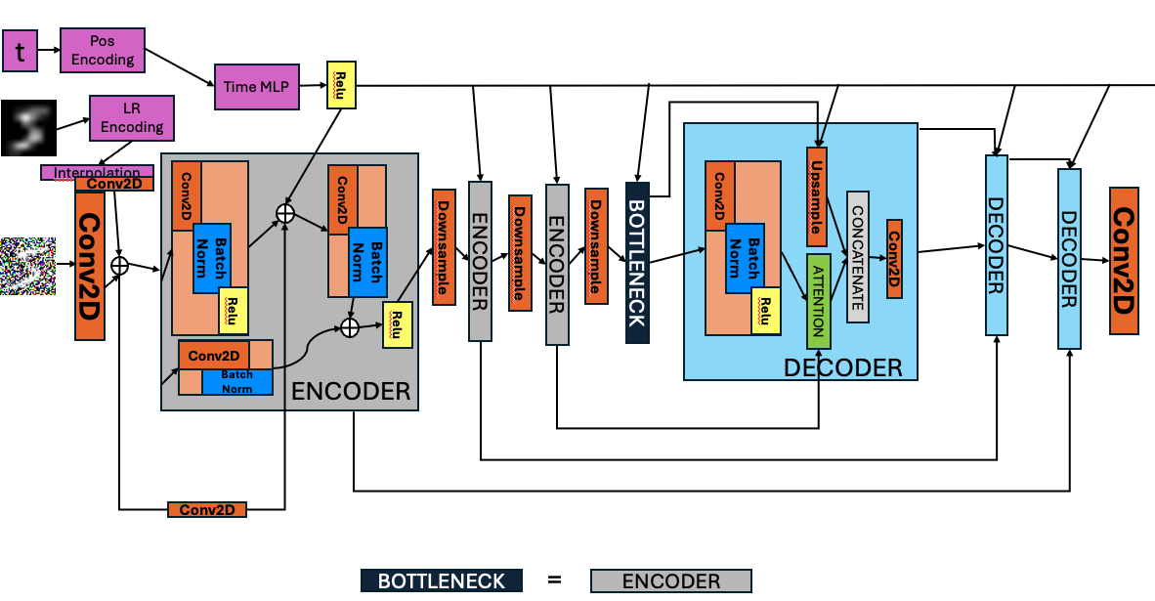
NOISE PREDICTOR
UNet

